Slide 1

Localebnb
An Airbnb Contextual Recommender
G Scott Stukey
Notes:
Hello everyone.
My name is G Scott Stukey, and I’d love to share with you my project: Localebnb – An Airbnb Contextual Recommender.
I’m going to go over the background of my project, dive into using my app, and then share the methodology & insights from this project.
[next slide]

Slide 2
Motivation
When booking a private residence,
how do you find the perfect neighborhood?
Notes:
The motivation behind the project was driven by the question:
“When booking a private residence, how do you find the perfect neighborhood?”
[next slide]

Slide 3
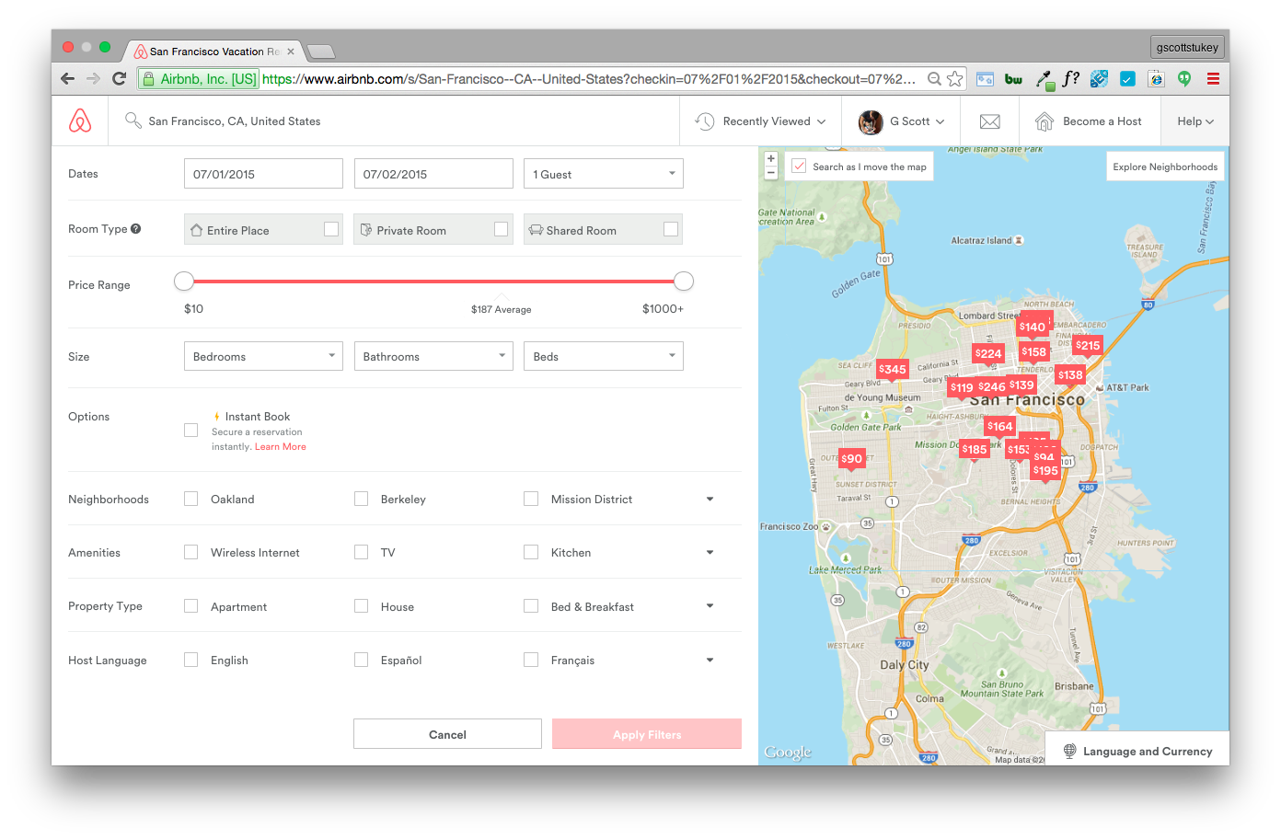
Problem
Airbnb search results
No ability to
search or filter
by trait!
Notes:
The problem I found with Airbnb’s search results is that there’s no ability to directly search or filter by neighborhood trait. [click]
They only have the neighborhood names.
Personal Story - when I was trying to book a trip to Montreal, I knew the type of neighborhood I wanted to stay in: somewhere a little more ‘hipster’ with great dining, away from the touristy spots. I ended up having a amazing experience staying at a converted loft in the De Lorimier neighborhood, but only after having to research a multitude of sources.
[next slide]

Slide 4
Hypothesis
Use Airbnb listing descriptions to predict neighborhood traits & customize search results to users’ preferences
Why Airbnb should implement this:
Increase user satisfaction by increasing relevance
Increase booking rate by reducing bounces (click fatigue)
Notes:
My hypothesis is that, by using Airbnb listing descriptions I could predict the traits of the neighborhood, and then customize the Airbnb default search results to a user’s preference.
From a business standpoint, by implementing this Airbnb could increase user satisfaction by making their search results more relevant & potentially increase bookings by reducing bounces that happen from click fatigue.
[next slide]

Slide 5
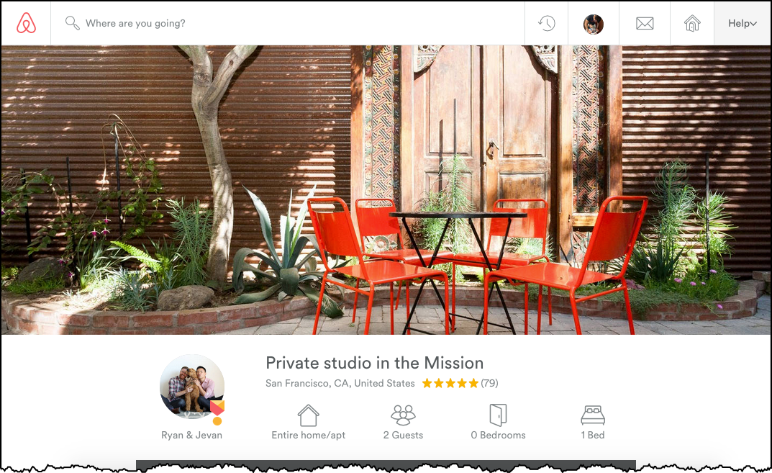
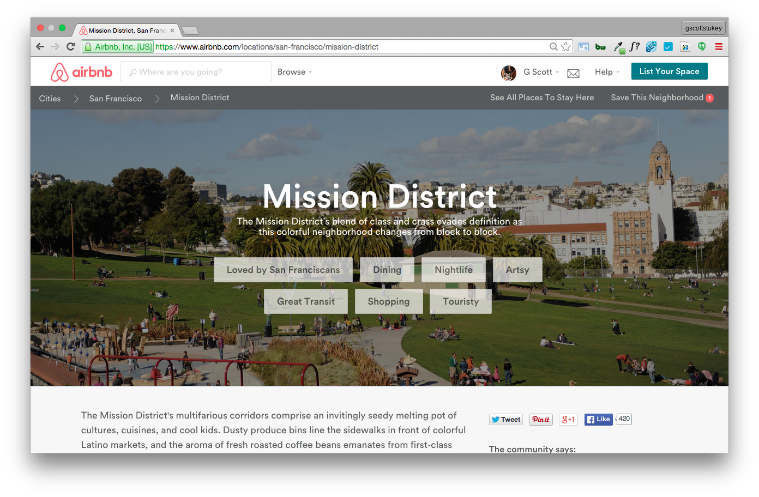
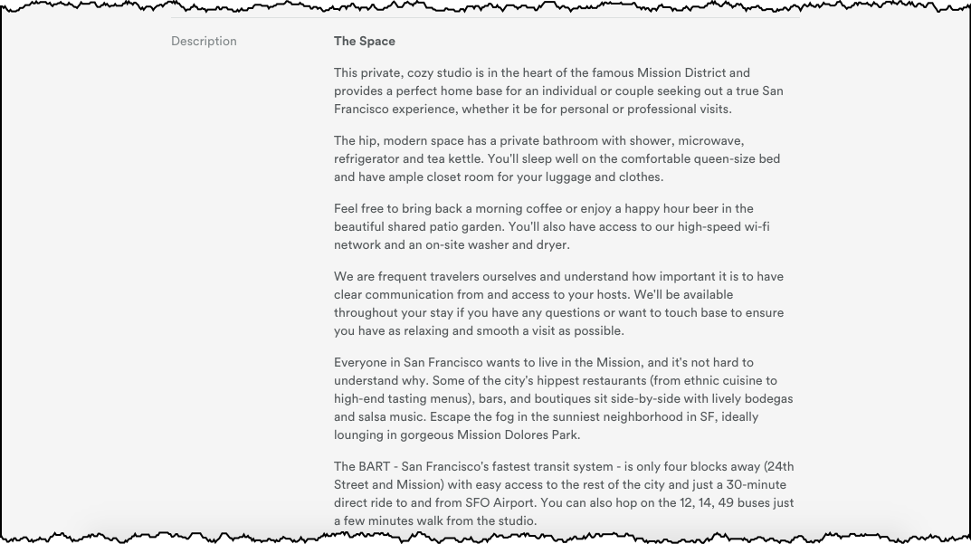
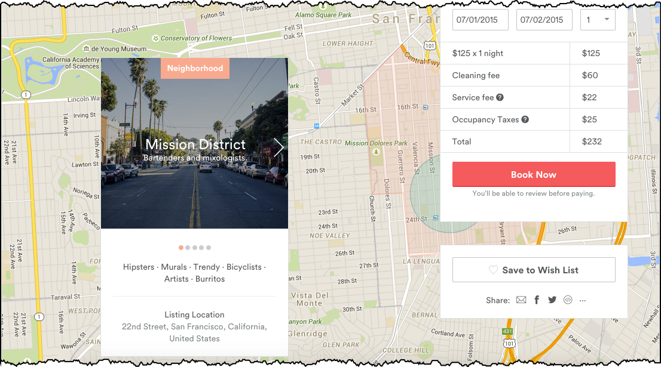
Solution
Listing Page
Neighborhood Guide
Features
Target
Notes:
The solution came from bubbling up information from the neighborhood guide, which is currently buried on their site. It contains amazing information about neighborhoods of select cities. [click]
I took the listing descriptions as my input features, mapped each listing’s neighborhood to the neighborhood guide, and used the neighborhood traits as my target variables. For Localebnb, I focused on a subset of 4 of the traits – ‘artsy’, ‘dining’, ‘shopping’ & ‘nightlife’.
Now, lets dive into the app.
[next slide]

Slide 6
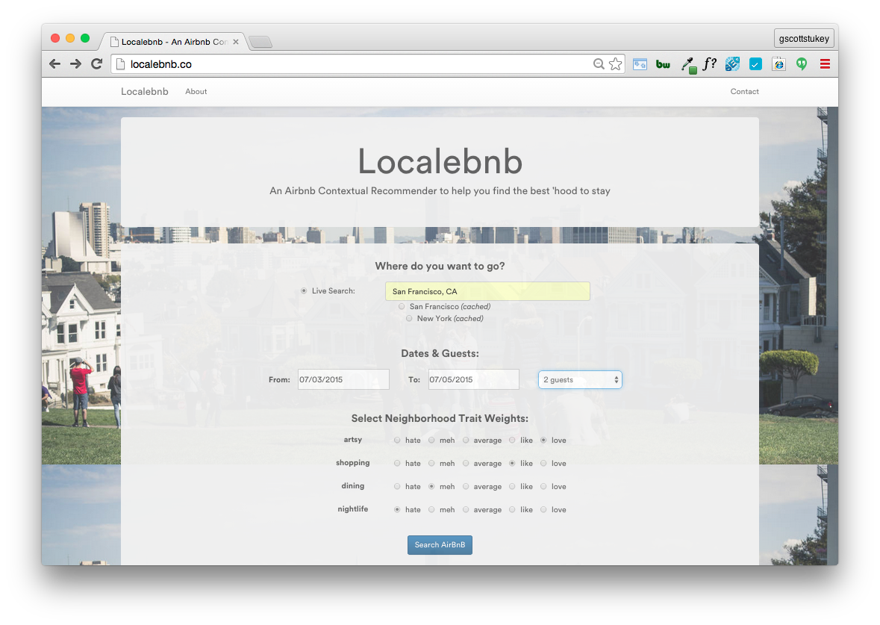
Notes:
This is Localebnb. The home page is a simple search page. [click]
Up top - you’re able to put in your search information. [click]
Down below, you’re able to select your preferences for the various neighborhood traits. Here, the user appears to enjoy artsy & shopping neighborhoods, while avoiding nightlife.
When the user clicks search…
[next slide]

Slide 7
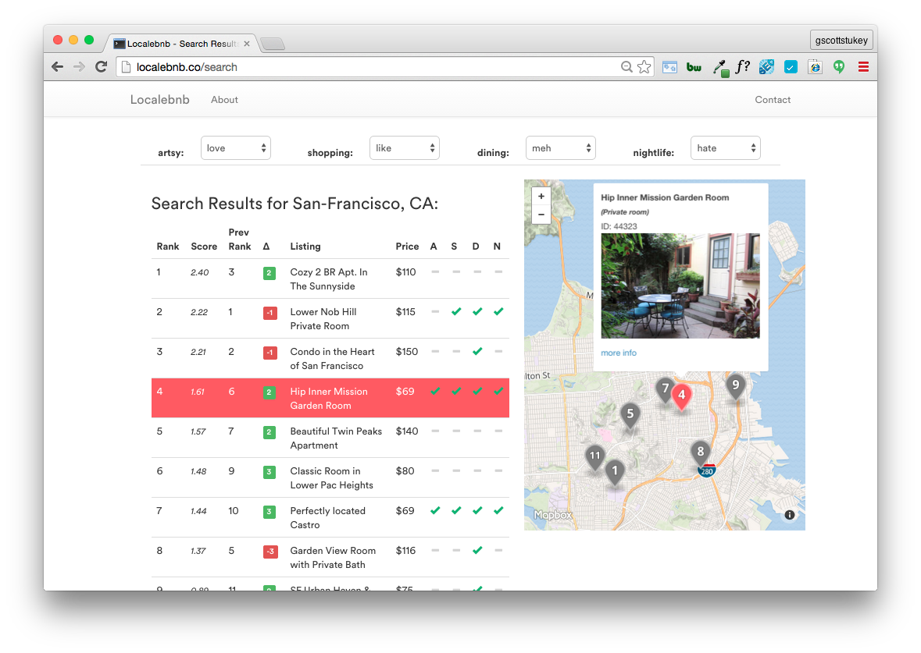
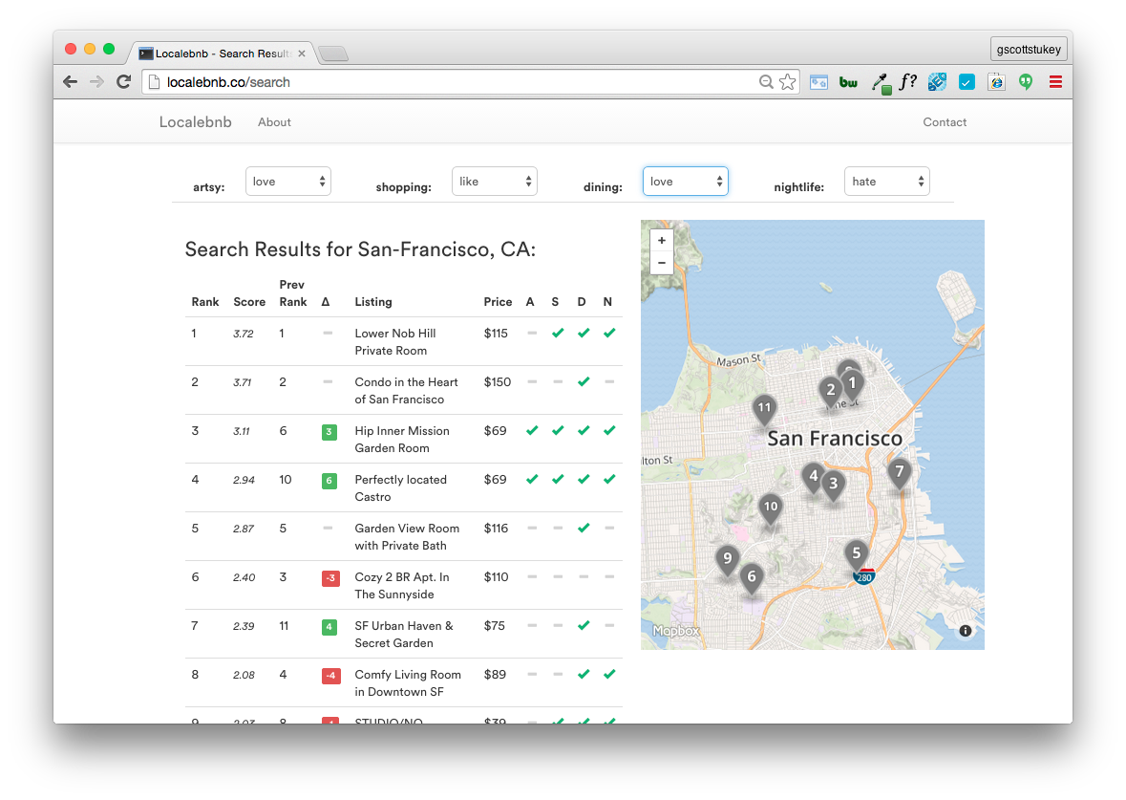
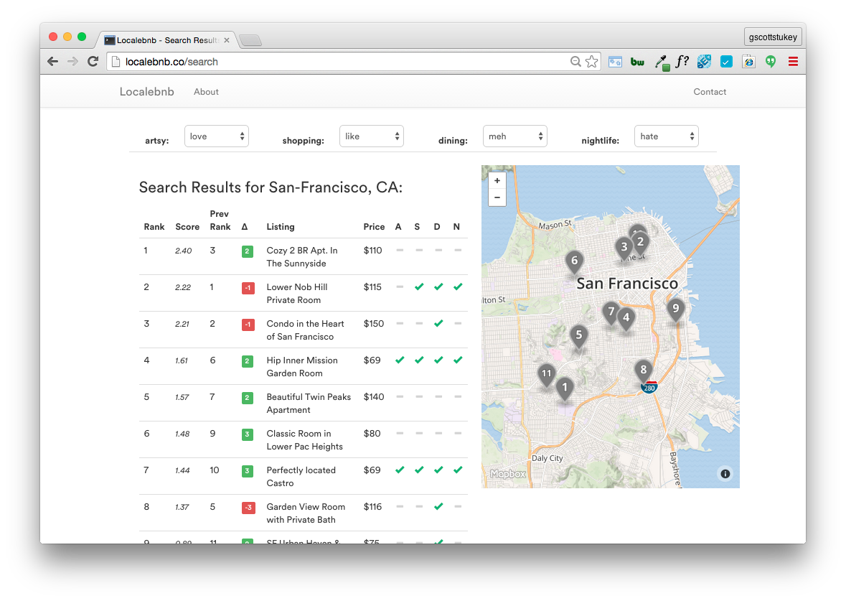
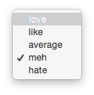
Notes:
…the search results appear. The app scraped Airbnb search results for listings, scraped each of those listings, predicted if each listing has a specific trait, then scored & re-sorted the search results based on the user’s preferences. [click]
When a user hovers over a listing, additional information about the listing pops up. [click]
The app also allows the user to change there preferences. [click] Here we see the user increases their preference for dining. [click] When they do this, the app auto-updates its results.
The user then found this gem in the Castro. Previously, this listing was at number 10 below the fold. Localebnb helped bubble that listing higher-up on the results page. This is a great example of the app’s benefits.
Now lets look at the methodology behind the project.
[next slide]

Slide 8
Methodology
Beautiful
Soup
+
ETL
Scraped Search Results & Listings
Scraped Neighborhood Traits
Prepping
Cleaned Documents (lemmatization, expand contractions, et al.)
NLTK
Modeling
Word2Vec / Doc2Vec
TF-IDF Vectorization
Naïve Bayes
SVM
Random Forest / GBC
Word2Vec
Rank/Sort
Implemented Custom Scoring Function (inspired by Google Search CTR by position)
Notes:
Here you can see my project’s pipeline:
As I mentioned earlier, I scraped ~4000 listings across SF & NYC and mapped them to the neighborhood traits.
I then used various NLP techniques to clean the documents.
To model the traits, I vectorized the descriptions & tried a variety of supervised models. What worked best were support vector machines, which is well suited for text classification. I also tested Doc2Vec, however I found my corpus to be too small to have useful results.
To rank them, I created a custom scoring function. The scores were loosely inspired by Google search’s click-thru rates by position, which tries to solve an analogous relevance problem.
[next slide]

Slide 9
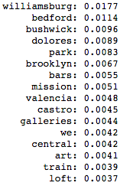
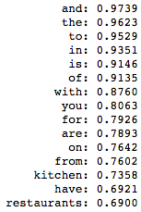
Insights
SVM
Forest
TF-IDF
Infrequent words add value
Neighborhood names dominate feature importance
Airbnb is for foodies
‘artsy’ model key words
doc frequency
78-82% accuracy
5 pt lift over naïve bayes
Notes:
I pulled out a few insights that the various models were able to provide:
From SVM, I saw that infrequent words add value. The models achieved accuracies of ~80%, with a 5 point life. The big difference is that the Naïve Bayes model used only 2000 of the words 16000 words found in the descriptions, while SVM used 8000.
From the Forest model, looking at information gain I confirmed intuition that the neighborhood names were key predictors of the traits. In addition, we see here the words “bars”, “galleries”, “art” and “loft” – all of which align with our expectations.
From our TF-IDF, I call out that “Airbnb is for foodies”. This is because the words “kitchen” and “restaurants” appear amongst the stop words, and were more common than words like “was”, “has”, etc.
[next slide]

Slide 10
Extensions
Scrape more descriptions across more cities
Include additional listing information in models
Make neighborhood traits more fluid
Give partial weight to nearby neighborhoods utilizing graph analytics
How Airbnb could benefit:
Guide creation of neighborhood guides in new cities
Notes:
If I were to continue my work on Localebnb, I would be interested in:
Scraping more listings across more cities (as we saw that neighborhood names were predictive, but they’re city specific)
Include additional listing information in the models (for example, the amenities or room type)
Also, to make the neighborhood traits more fluid that “yes” or “no” – which could be done by giving partial weight to nearby neighborhoods using graph analytics techniques.
In addition, Airbnb’s content team could leverage this model for neighborhood guide creation or validation.
[next slide]

Slide 11
Thank You
Go to Localebnb.co to try for yourselves.
@gscottstukey
Notes:
The app is live and can be seen at Localebnb.co – it’s also best viewed on desktop.
Thank you.
[End]

